Slide 1
CS 43105 Data Mining Techniques
Xiang Lian
Department of Computer Science
Kent State University
Email: xlian@kent.edu
Homepage: http://www.cs.kent.edu/~xlian/

Slide 2
Welcome to CS 43105 Class!
Instructor: Xiang Lian
Homepage: http://www.cs.kent.edu/~xlian/
Office: MSB 264
Email: xlian@kent.edu
Office hour: Tuesday and Thursday (10am ~ 12:30pm), or by appointment

Slide 3
CS 43105 Data Mining Techniques
Course website: http://www.cs.kent.edu/~xlian/2019Fall_CS43105.html
Prerequisite: CS 33007 Introduction to Database System Design
Location: Mathematics and Computer Science Building (MSB), 115
Time: 12:30pm - 1:45pm, MW
Blackboard: https://learn.kent.edu/

Slide 4
CS 43105 Data Mining Techniques
Textbook
Ian H. Witten, Eibe Frank, and Mark A. Hall. Data Mining: Practical Machine Learning Tools and Techniques: 3rd Edition. ISBN-13: 9780123748560, Publisher: Elsevier Science, Publication date: 1/20/2011.
Reference Books
Jiawei Han, Micheline Kamber and Jian Pei. Data Mining: Concepts and Techniques. The Morgan Kaufmann Series in Data Management Systems, Morgan Kaufmann Publishers, July 2011. ISBN 978-0123814791. https://hanj.cs.illinois.edu/bk3/bk3_slidesindex.htm
Mohammed J. Zaki and Wagner Meira. Data Mining and Analysis: Fundamental Concepts and Algorithms. 1st Edition. Cambridge University Press, May 12, 2014. ISBN-13: 978-0521766333.

Slide 5
Online Resources
ACM digital library
http://dl.acm.org/
IEEE Xplore Digital Library
http://ieeexplore.ieee.org/Xplore/home.jsp
DBLP
http://dblp.uni-trier.de/

Slide 6
Online Resources (cont'd)
Conferences
SIGKDD: https://dblp.uni-trier.de/db/conf/kdd/index.html
ICDM: https://dblp1.uni-trier.de/db/conf/icdm/index.html
SIGMOD: http://dblp.uni-trier.de/db/conf/sigmod/
VLDB: http://www.vldb.org/pvldb/, or http://dblp.uni-trier.de/db/journals/pvldb/index.html
ICDE: http://ieeexplore.ieee.org/xpl/conhome.jsp?punumber=1000178, or http://dblp.uni-trier.de/db/conf/icde/

Slide 7
Scoring and Grading
5% - Attendance & Questions
50% - 5 Homeworks (10 points each)
45% - Research Projects & Presentations
Research project report (including introduction, related works, problem definition, solutions, experiments, and conclusions) (30%)
Presentation and demonstration for the proposed research project (15%)
5% - Bonus Points, rated by other team members
10% - (Optional) Bonus for presenting research papers

Slide 8
Scoring and Grading (cont'd)
A = 90 or higher
B = 80 - 89
C = 70 - 79
D = 60 - 69
F = <60
The maximum score you can get is: 115!

Slide 9
Study Group
Please form a team with 3-4 team members
The workload should be distributed evenly to each team member
Group Assignments
1 Project + 1 Presentation
Individual Assignments
5 homework

Slide 10
Academic Dishonesty Policy
Warning: Do not copy from any sources
Any form of academic dishonesty will be strictly forbidden and will be punished to the maximum extent
Allowing another student to copy one's work will be treated as an act of academic dishonesty, leading to the same penalty as copying

Slide 11
Data Mining Topics
Association Rule
Sequential Patterns
Clustering and Outlier Detection
Classification and Prediction
Web Mining
Graph Mining
Regression
Bayesian Inference
Information Theory
Markov Chain and Random Walk

Slide 12
CS 43105 Data Mining Techniques Chapter 1 Introduction
Xiang Lian
Department of Computer Science
Kent State University
Email: xlian@kent.edu
Homepage: http://www.cs.kent.edu/~xlian/
Notes:
References
https://hanj.cs.illinois.edu/bk3/
http://www.cs.kent.edu/~jin/DM11/DM11.html

Slide 13
Outline
Why Data Mining?
What is (not) Data Mining?
Data to Be Mined
Data Mining Classifications/Tasks
Evaluation of the Mined Knowledge
Data Mining Applications
Data Mining References

Slide 14
Why Data Mining?
The Explosive Growth of Data: from terabytes to petabytes
Data collection and data availability
Automated data collection tools, database systems, Web, computerized society
Major sources of abundant data
Business: Web, e-commerce, transactions, stocks, …
Science: Remote sensing, bioinformatics, scientific simulation, …
Society and everyone: news, digital cameras, YouTube
We are drowning in data, but starving for knowledge!
“Necessity is the mother of invention”—Data mining—Automated analysis of massive data sets

Slide 15

Why Data Mining? Commercial Viewpoint
Lots of data is being collected and warehoused
Web data, e-commerce
purchases at department/ grocery stores
Bank/Credit Card transactions
Computers have become cheaper and more powerful
Competitive Pressure is Strong
Provide better, customized services for an edge (e.g. in Customer Relationship Management)

Slide 16
Let us look at some examples
Netflix
Amazon
Wal-Mart
Algorithmic Trading/High Frequency Trading
Banks (Segmint)
Google/Yahoo/Microsoft/IBM
CRM/Consumer Behavior Profiling
Consumer Review
Mobile Ads
Social Network (Facebook/Twitter/Google+)
…

Slide 17
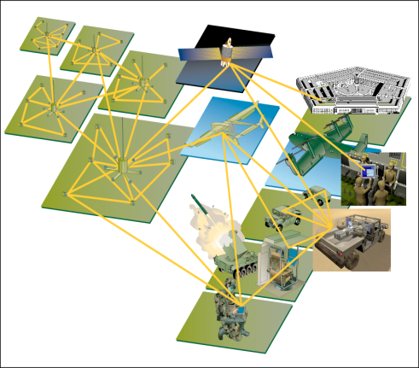
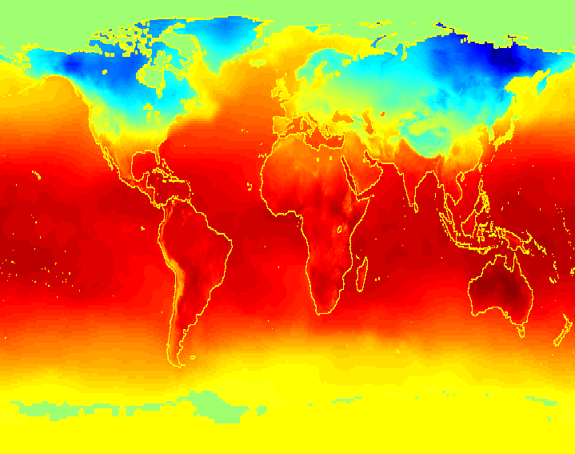
Why Data Mining? Scientific Viewpoint
Data collected and stored at enormous speeds (GB/hour)
remote sensors on a satellite
telescopes scanning the skies
microarrays generating gene expression data
scientific simulations generating terabytes of data
Traditional techniques infeasible for raw data
Data mining may help scientists
in classifying and segmenting data
in Hypothesis Formation

Slide 18
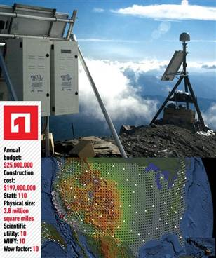
The Earthscope
1.
The Earthscope is one of the world's largest science projects. Designed to track North America's geological evolution, this observatory records data over 3.8 million square miles, amassing 67 terabytes of data. It analyzes seismic slips in the San Andreas fault, sure, but also the plume of magma underneath Yellowstone and much, much more. (http://www.msnbc.msn.com/id/44363598/ns/technology_and_science-future_of_technology/#.TmetOdQ--uI)

Slide 19
Mining Large Data Sets - Motivation
There is often information “hidden” in the data that is not readily evident
Human analysts may take weeks to discover useful information
Much of the data is never analyzed at all

Slide 20

What is Data Mining?
Many Definitions of Data mining (knowledge discovery from data)
Extraction of interesting (non-trivial, implicit, previously unknown and potentially useful) patterns or knowledge from huge amount of data
Exploration & analysis, by automatic or semi-automatic means, of large quantities of data in order to discover meaningful patterns

Slide 21
What is Data Mining? (cont'd)
Alternative names
Knowledge discovery (mining) in databases (KDD), knowledge extraction, data/pattern analysis, data archeology, data dredging, information harvesting, business intelligence, etc.
Watch out: Is everything “data mining”?
Simple search and query processing
(Deductive) expert systems

Slide 22
What is (not) Data Mining?
What is not Data Mining?
Look up phone number in phone directory
Query a Web search engine for information about “Amazon”
What is Data Mining?
Certain names are more prevalent in certain US locations (O’Brien, O’Rurke, O’Reilly… in Boston area)
Group together similar documents returned by search engine according to their context (e.g. Amazon rainforest, Amazon.com,)

Slide 23
Knowledge Discovery (KDD) Process
Knowledge
This is a view from typical database systems and data warehousing communities
Data mining plays an essential role in the knowledge discovery process
Pattern Evaluation
Data Mining
Task-Relevant Data
Data Warehouse
Selection
Data Cleaning
Data Integration
Databases

Slide 24
Example: A Web Mining Framework
Web mining usually involves
Data cleaning
Data integration from multiple sources
Warehousing the data
Data cube construction
Data selection for data mining
Data mining
Presentation of the mining results
Patterns and knowledge to be used or stored into knowledge-base

Slide 25
Data Mining in Business Intelligence
Increasing potential
to support
business decisions
End User
Decision Making
Data Presentation
Business
Analyst
Visualization Techniques
Data Mining
Data
Analyst
Information Discovery
Data Exploration
Statistical Summary, Querying, and Reporting
Data Preprocessing/Integration, Data Warehouses
Data Sources
DBA
Paper, Files, Web documents, Scientific experiments, Database Systems

Slide 26
KDD Process: A Typical View from ML and Statistics
Pattern
Information
Knowledge
Input Data
Data Pre-Processing
Data Mining
Post-Processing
Data integration
Normalization
Feature selection
Dimension reduction
Pattern discovery
Association & correlation
Classification
Clustering
Outlier analysis
… … … …
Pattern evaluation
Pattern selection
Pattern interpretation
Pattern visualization
This is a view from typical machine learning and statistics communities

Slide 27
Example: Medical Data Mining
Health care & medical data mining – often adopted such a view in statistics and machine learning
Preprocessing of the data (including feature extraction and dimension reduction)
Classification or/and clustering processes
Post-processing for presentation

Slide 28
Origins of Data Mining
Draws ideas from machine learning/AI, pattern recognition, statistics, and database systems
Traditional techniques may be unsuitable due to
Enormity of data
High dimensionality of data
Heterogeneous, distributed nature of data
Statistics/ AI
Machine Learning/
Pattern Recognition
Data Mining
Database systems

Slide 29
Confluence of More Disciplines
Machine
Learning
Pattern
Recognition
Statistics
Applications
Data Mining
Visualization
Algorithm
Database
Technology
High-Performance
Computing

Slide 30
Data Mining: On What Kinds of Data?
Database-oriented data sets and applications
Relational database, data warehouse, transactional database
Advanced data sets and advanced applications
Data streams and sensor data
Time-series data, temporal data, sequence data (incl. bio-sequences)
Structure data, graphs, social networks and multi-linked data
Object-relational databases
Heterogeneous databases and legacy databases
Spatial data and spatiotemporal data
Multimedia databases
Text databases
The World-Wide Web
Graph databases

Slide 31
Data Mining Tasks
Prediction Methods
Use some variables to predict unknown or future values of other variables
Description Methods
Find human-interpretable patterns that describe the data
From [Fayyad, et.al.] Advances in Knowledge Discovery and Data Mining, 1996

Slide 32
Data Mining Tasks (cont'd)
Classification [Predictive]
Clustering [Descriptive]
Association Rule Discovery [Descriptive]
Sequential Pattern Discovery [Descriptive]
Regression [Predictive]
Deviation Detection [Predictive]

Slide 33
Classification: Definition
Given a collection of records (training set )
Each record contains a set of attributes, one of the attributes is the class.
Find a model for class attribute as a function of the values of other attributes.
Goal: previously unseen records should be assigned a class as accurately as possible.
A test set is used to determine the accuracy of the model. Usually, the given data set is divided into training and test sets, with training set used to build the model and test set used to validate it.

Slide 34
Classification Example
categorical
categorical
continuous
class
Test
Set
Learn
Classifier
Training
Set
Model

Slide 35
Classification: Application 1
Direct Marketing
Goal: Reduce cost of mailing by targeting a set of consumers likely to buy a new cell-phone product.
Approach:
Use the data for a similar product introduced before.
We know which customers decided to buy and which decided otherwise. This {buy, don’t buy} decision forms the class attribute.
Collect various demographic, lifestyle, and company-interaction related information about all such customers.
Type of business, where they stay, how much they earn, etc.
Use this information as input attributes to learn a classifier model.
From [Berry & Linoff] Data Mining Techniques, 1997

Slide 36
Classification: Application 2
Fraud Detection
Goal: Predict fraudulent cases in credit card transactions.
Approach:
Use credit card transactions and the information on its account-holder as attributes.
When does a customer buy, what does he buy, how often he pays on time, etc
Label past transactions as fraud or fair transactions. This forms the class attribute.
Learn a model for the class of the transactions.
Use this model to detect fraud by observing credit card transactions on an account.

Slide 37
Classification: Application 3
Customer Attrition/Churn:
Goal: To predict whether a customer is likely to be lost to a competitor.
Approach:
Use detailed record of transactions with each of the past and present customers, to find attributes.
How often the customer calls, where he calls, what time-of-the day he calls most, his financial status, marital status, etc.
Label the customers as loyal or disloyal.
Find a model for loyalty.
From [Berry & Linoff] Data Mining Techniques, 1997

Slide 38
Classification: Application 4
Sky Survey Cataloging
Goal: To predict class (star or galaxy) of sky objects, especially visually faint ones, based on the telescopic survey images (from Palomar Observatory).
3000 images with 23,040 x 23,040 pixels per image.
Approach:
Segment the image.
Measure image attributes (features) - 40 of them per object.
Model the class based on these features.
Success Story: Could find 16 new high red-shift quasars, some of the farthest objects that are difficult to find!
From [Fayyad, et.al.] Advances in Knowledge Discovery and Data Mining, 1996

Slide 39
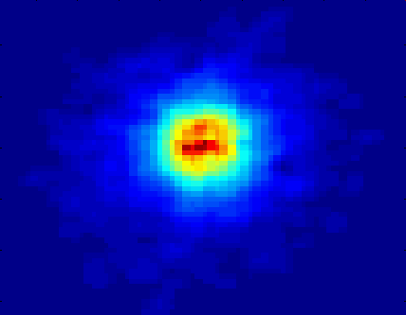
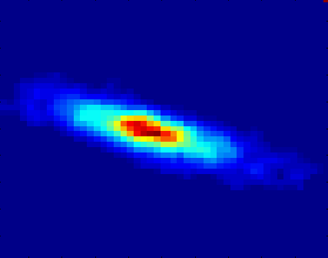
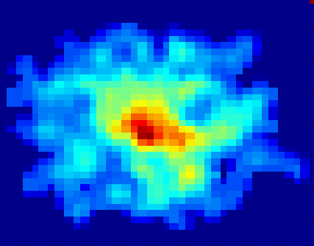
Classifying Galaxies
Courtesy: http://aps.umn.edu
Early
Class:
Stages of Formation
Attributes:
Image features,
Characteristics of light waves received, etc.
Intermediate
Late
Data Size:
72 million stars, 20 million galaxies
Object Catalog: 9 GB
Image Database: 150 GB

Slide 40
Clustering Definition
Given a set of data points, each having a set of attributes, and a similarity measure among them, find clusters such that
Data points in one cluster are more similar to one another.
Data points in separate clusters are less similar to one another.
Similarity Measures:
Euclidean Distance if attributes are continuous.
Other Problem-specific Measures.

Slide 41
Illustrating Clustering
Euclidean Distance Based Clustering in 3-D space.
Intracluster distances
are minimized
Intercluster distances
are maximized

Slide 42
Clustering: Application 1
Market Segmentation:
Goal: subdivide a market into distinct subsets of customers where any subset may conceivably be selected as a market target to be reached with a distinct marketing mix.
Approach:
Collect different attributes of customers based on their geographical and lifestyle related information.
Find clusters of similar customers.
Measure the clustering quality by observing buying patterns of customers in same cluster vs. those from different clusters.

Slide 43
Clustering: Application 2
Document Clustering:
Goal: To find groups of documents that are similar to each other based on the important terms appearing in them.
Approach: To identify frequently occurring terms in each document. Form a similarity measure based on the frequencies of different terms. Use it to cluster.
Gain: Information Retrieval can utilize the clusters to relate a new document or search term to clustered documents.

Slide 44
Illustrating Document Clustering
Clustering Points: 3204 Articles of Los Angeles Times.
Similarity Measure: How many words are common in these documents (after some word filtering).

Slide 45
Clustering of S&P 500 Stock Data
Observe Stock Movements every day.
Clustering points: Stock-{UP/DOWN}
Similarity Measure: Two points are more similar if the events described by them frequently happen together on the same day.
We used association rules to quantify a similarity measure.

Slide 46
Association Rule Discovery: Definition
Given a set of records each of which contain some number of items from a given collection;
Produce dependency rules which will predict occurrence of an item based on occurrences of other items.
Rules Discovered:
{Milk} --> {Coke}
{Diaper, Milk} --> {Beer}

Slide 47
Association Rule Discovery: Application 1
Marketing and Sales Promotion:
Let the rule discovered be
{Bagels, … } --> {Potato Chips}
Potato Chips as consequent => Can be used to determine what should be done to boost its sales.
Bagels in the antecedent => Can be used to see which products would be affected if the store discontinues selling bagels.
Bagels in antecedent and Potato chips in consequent => Can be used to see what products should be sold with Bagels to promote sale of Potato chips!

Slide 48
Association Rule Discovery: Application 2
Supermarket shelf management.
Goal: To identify items that are bought together by sufficiently many customers.
Approach: Process the point-of-sale data collected with barcode scanners to find dependencies among items.
A classic rule --
If a customer buys diaper and milk, then he is very likely to buy beer.
So, don’t be surprised if you find six-packs stacked next to diapers!

Slide 49
Association Rule Discovery: Application 3
Inventory Management:
Goal: A consumer appliance repair company wants to anticipate the nature of repairs on its consumer products and keep the service vehicles equipped with right parts to reduce on number of visits to consumer households.
Approach: Process the data on tools and parts required in previous repairs at different consumer locations and discover the co-occurrence patterns.

Slide 50
Sequential Pattern Discovery: Definition
Given is a set of objects, with each object associated with its own timeline of events, find rules that predict strong sequential dependencies among different events.
Rules are formed by first discovering patterns. Event occurrences in the patterns are governed by timing constraints.
(A B) (C) (D E)
(A B) (C) (D E)
<= xg
>ng
<= ws
<= ms

Slide 51
Sequential Pattern Discovery: Examples
In telecommunications alarm logs,
(Inverter_Problem Excessive_Line_Current)
(Rectifier_Alarm) --> (Fire_Alarm)
In point-of-sale transaction sequences,
Computer Bookstore:
(Intro_To_Visual_C) (C++_Primer) --> (Perl_for_dummies,Tcl_Tk)
Athletic Apparel Store:
(Shoes) (Racket, Racketball) --> (Sports_Jacket)

Slide 52
Regression
Predict a value of a given continuous valued variable based on the values of other variables, assuming a linear or nonlinear model of dependency
Greatly studied in statistics, neural network fields
Examples:
Predicting sales amounts of new product based on advertising expenditure
Predicting wind velocities as a function of temperature, humidity, air pressure, etc.
Time series prediction of stock market indices

Slide 53
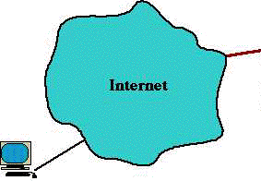
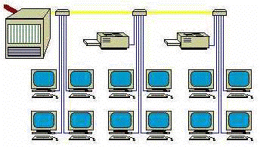
Deviation/Anomaly Detection
Detect significant deviations from normal behavior
Applications:
Credit Card Fraud Detection
Network Intrusion Detection
Typical network traffic at University level may reach over 100 million connections per day

Slide 54




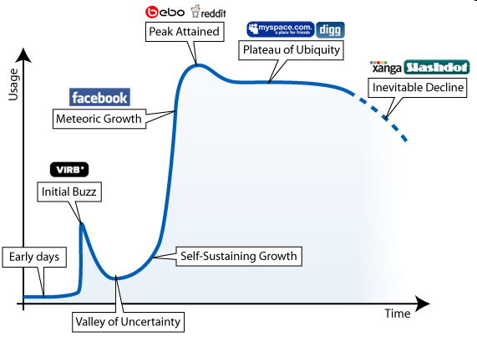




Ubiquitous Networks
Complex networks are large networks where local behavior generates non-trivial global features.
http://belanger.wordpress.com/2007/06/28/ the-ebb-and-flow-of-social-networking/
Social Networks
54
Notes:
Complex Networks are fascinating because they achieve non-trivial global properties through local interactions. They occur either in the natural world (bio), or are the constructs of humanity (social, econ, polit, technology)
Many if not most complex networks are dynamic.
Ashton Kutcher, Kevin Beacon, Oprah Winfrey, Charlee Sheens
54

Slide 55
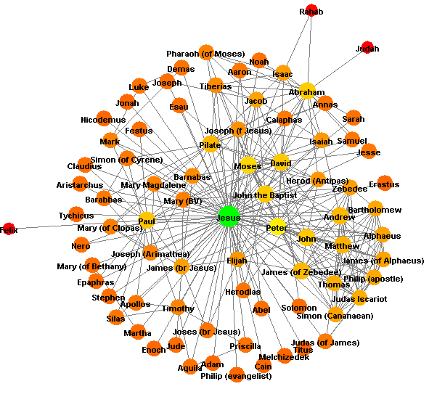
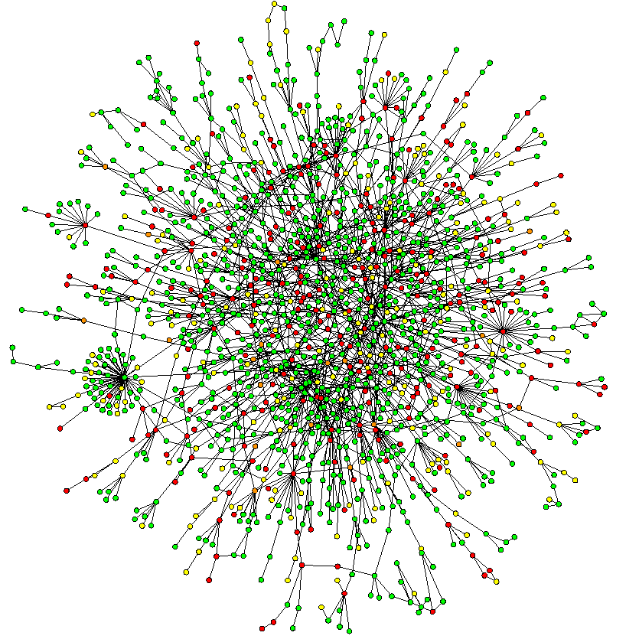
More Networks

Slide 56

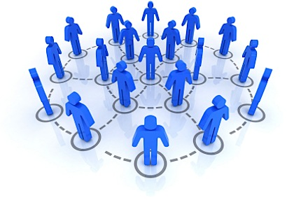
Examples of Complex Networks
Biological networks
Regulatory networks
Metabolic networks
Protein-protein interaction networks
Social networks
Bibliographic networks
Knowledge graphs in Semantic Web

Slide 57

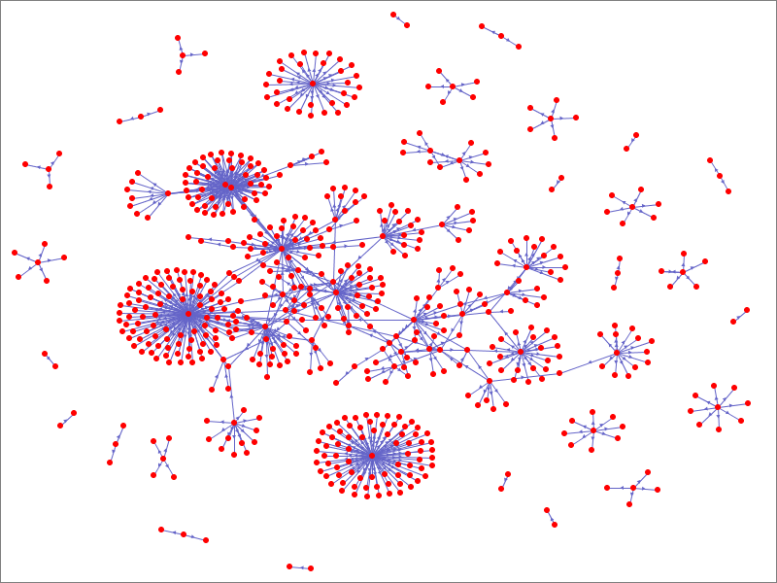
Complex Networks – Clustering
Network Clustering
Clustering coefficients – how well connected?
What does a complex network look like when you can really see it?
Community discovery-separate into densely connected subsets
Automatic discovery of communities
Split by interest or meaning

Slide 58
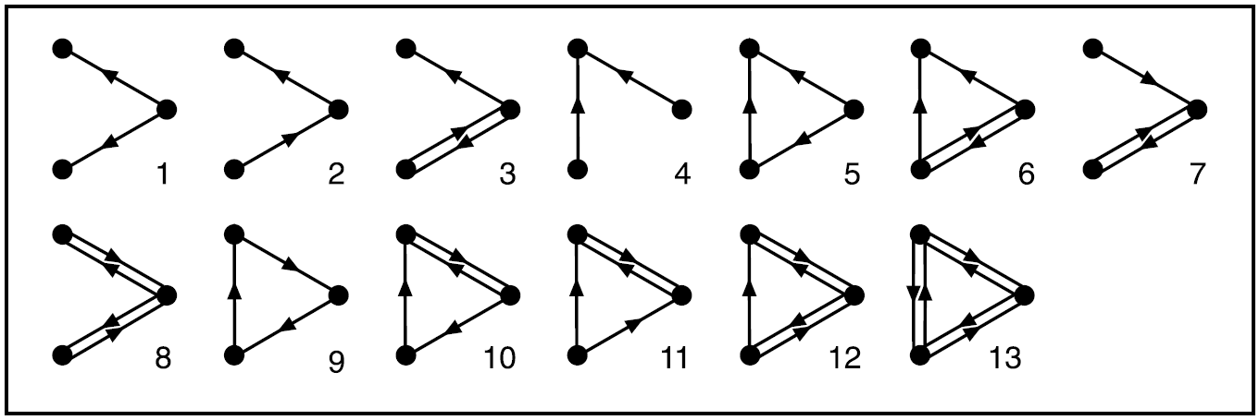
Complex Networks – Network Motif
Network Motifs [Uri Alon]
Are there subgraph patterns that appear more frequently than others?
13 possible 3-node directed connected graphs
Do any of these subgraphs hold special meaning for a complex network?

Slide 59
Evaluation of Knowledge
Are all mined knowledge interesting?
One can mine tremendous amount of “patterns” and knowledge
Some may fit only certain dimension space (time, location, …)
Some may not be representative, may be transient, …
Evaluation of mined knowledge → directly mine only interesting knowledge?
Descriptive vs. predictive
Coverage
Typicality vs. novelty
Accuracy
Timeliness
…

Slide 60
Applications of Data Mining
Web page analysis: from web page classification, clustering to PageRank & HITS algorithms
Collaborative analysis & recommender systems
Basket data analysis to targeted marketing
Biological and medical data analysis: classification, cluster analysis (microarray data analysis), biological sequence analysis, biological network analysis
Data mining and software engineering (e.g., IEEE Computer, Aug. 2009 issue)
From major dedicated data mining systems/tools (e.g., SAS, MS SQL-Server Analysis Manager, Oracle Data Mining Tools) to invisible data mining

Slide 61
Conferences and Journals on Data Mining
KDD Conferences
ACM SIGKDD Int. Conf. on Knowledge Discovery in Databases and Data Mining (KDD)
SIAM Data Mining Conf. (SDM)
(IEEE) Int. Conf. on Data Mining (ICDM)
European Conf. on Machine Learning and Principles and practices of Knowledge Discovery and Data Mining (ECML-PKDD)
Pacific-Asia Conf. on Knowledge Discovery and Data Mining (PAKDD)
Int. Conf. on Web Search and Data Mining (WSDM)
Other related conferences
DB conferences: ACM SIGMOD, VLDB, ICDE, EDBT, ICDT, …
Web and IR conferences: WWW, SIGIR, WSDM
ML conferences: ICML, NIPS
PR conferences: CVPR,
Journals
Data Mining and Knowledge Discovery (DAMI or DMKD)
IEEE Trans. On Knowledge and Data Eng. (TKDE)
KDD Explorations
ACM Trans. on KDD

Slide 62
Where to Find References? DBLP, Google Scholar, …
Data mining and KDD
Conferences: ACM-SIGKDD, IEEE-ICDM, SIAM-DM, PKDD, PAKDD, etc.
Journal: Data Mining and Knowledge Discovery, KDD Explorations, ACM TKDD
Database systems
Conferences: ACM-SIGMOD, ACM-PODS, VLDB, IEEE-ICDE, EDBT, ICDT, DASFAA
Journals: IEEE-TKDE, ACM-TODS/TOIS, JIIS, J. ACM, VLDB J., Info. Sys., etc.
AI & Machine Learning
Conferences: Machine learning (ML), AAAI, IJCAI, COLT (Learning Theory), CVPR, NIPS, etc.
Journals: Machine Learning, Artificial Intelligence, Knowledge and Information Systems, IEEE-PAMI, etc.
Web and IR
Conferences: SIGIR, WWW, CIKM, etc.
Journals: WWW: Internet and Web Information Systems,
Statistics
Conferences: Joint Stat. Meeting, etc.
Journals: Annals of statistics, etc.
Visualization
Conference proceedings: CHI, ACM-SIGGraph, etc.
Journals: IEEE Trans. visualization and computer graphics, etc.

